Slide 1

Vel Tech Rangarajan Dr. Sagunthala R&D Institute of Science and Technology
School of Computing
Department of Computer Science and Engineering
10211CS224 / FULL STACK APPLICATION DEVELOPMENT (JAVA)
END SEMESTER PROJECT REVIEW
Date:06-05-2026
EVENT TICKET BOOKING SYSTEM
SDG: SDG 4 – Quality Education
Presented By:
M.Reshmika – VTU25804– 23UECS0330
Courses Handling Faculty:
Dr.M.SUMITHRA –ASSISTANT PROFESSOR(SG)

Slide 2
INTRODUCTION
1
The management of campus events in many institutions is often handled manually, leading to issues such as poor coordination, ticket mismanagement, and lack of real-time updates. This creates inconvenience for both organizers and participants. Hence, there is a need for a centralized digital system to streamline event operations. The proposed project, addresses these challenges by providing an efficient platform for event creation, ticket booking, and management. It is important as it enhances user experience, reduces manual effort, and ensures accurate record maintenance. In real-world scenarios, such systems are widely used in universities, conferences, and large-scale events. EVENTSYS is a dynamic web-based application that enables users to browse events, book tickets, and receive instant confirmations, while administrators can manage events and monitor bookings effectively.
.
2
3
4
5
6
7
8
9

Slide 3
PROBLEM STATEMENT
1
The management of campus events in many institutions is often handled manually, leading to issues such as poor coordination, ticket mismanagement, and lack of real-time updates. This creates inconvenience for both organizers and participants. Hence, there is a need for a centralized digital system to streamline event operations. The proposed project, addresses these challenges by providing an efficient platform for event creation, ticket booking, and management. It is important as it enhances user experience, reduces manual effort, and ensures accurate record maintenance. In real-world scenarios, such systems are widely used in universities, conferences, and large-scale events. EVENTSYS is a dynamic web-based application that enables users to browse events, book tickets, and receive instant confirmations, while administrators can manage events and monitor bookings effectively.
2
3
4
5
6
7
8
9

Slide 4
OBJECTIVE(S)
1
To develop a centralized platform to manage campus events efficiently
Enable users to view events, book tickets, and get instant confirmations
Provide admins with tools to create, update, and monitor events
To design a scalable and efficient backend system using microservices architecture and a MySQL database for secure data management.
2
3
4
5
6
7
8
9

Slide 5
PROPOSED SYSTEM
1
Provides a centralized web platform for managing all campus events
Allows users to easily browse events and book tickets online Enables real-time updates on event
Details and ticket availability Automates booking confirmation through instant notifications.
Displays real-time event details, seat availability, and booking status to users.
Reduces manual errors and improves data accuracy
Simplifies event management for administrators with a dedicated dashboard
Enhances user experience with a smooth and interactive interface
2
3
4
5
6
7
8
9

Slide 6
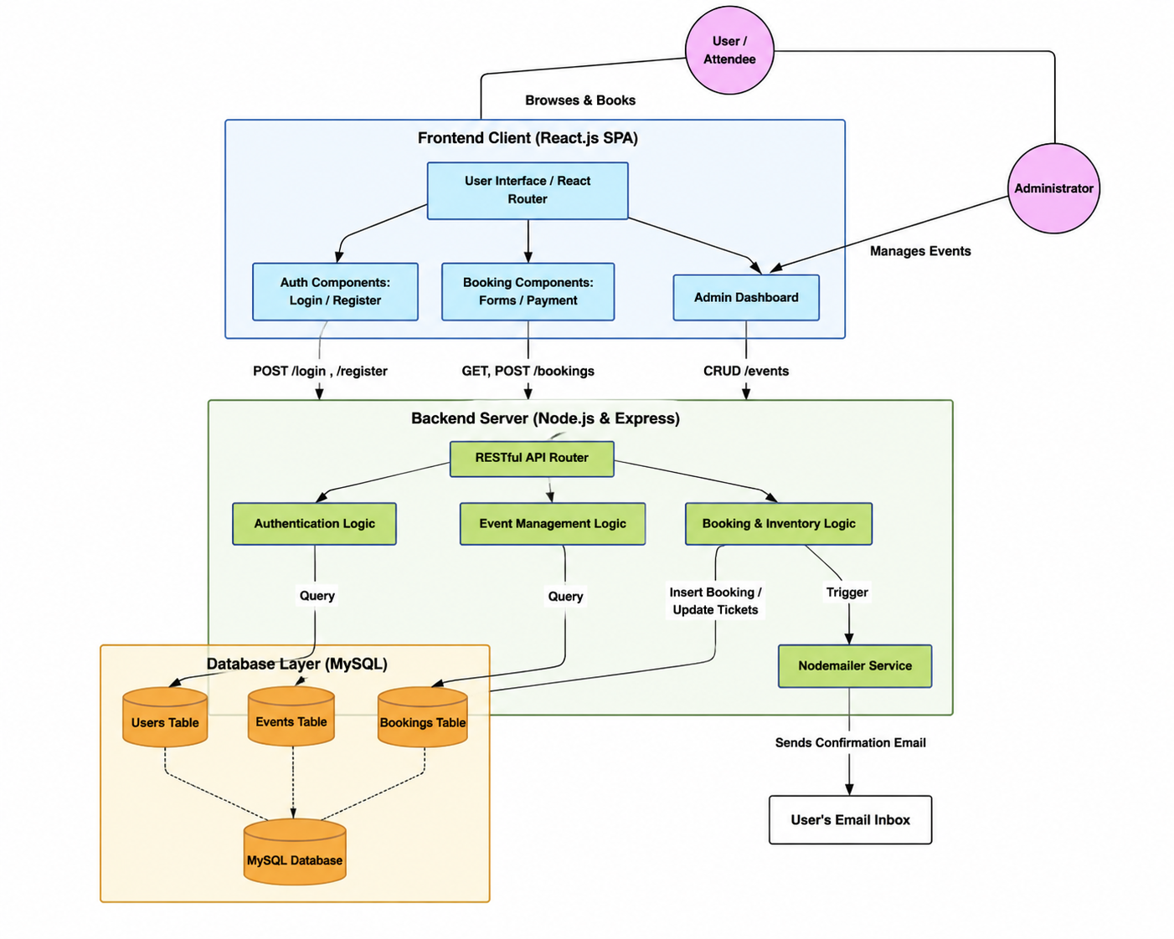
PROPOSED SYSTEM ARCHITECTURE
1
2
3
4
5
6
7
8
9

Slide 7
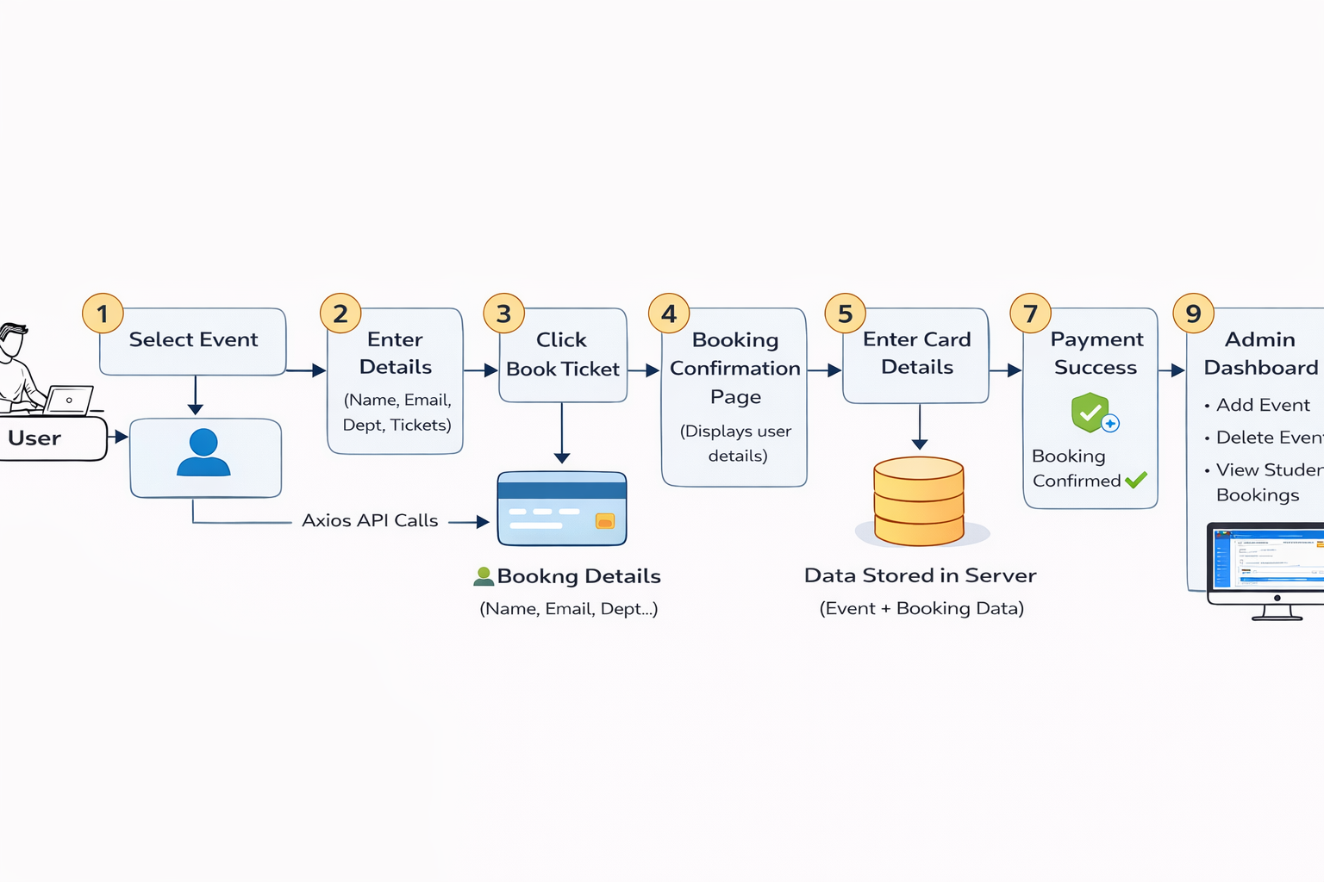
WORKFLOW
1
2
3
4
5
6
7
8
9

Slide 8
TECHNOLOGIES USED
Frontend: HTML, CSS, REACTJS (VS CODE)
Backend: SPRINGBOOT WITH ORM (ECLIPSE)
API Communication: RESTful APIs
Database: MySQL
1
2
3
4
5
6
7
8
9

Slide 9
MODULE DESCRIPTION
Module 1: User Management
Handles user registration and login for customers and admin
Provides secure authentication and authorization
Module 2: Event Management
Allows admin to create, update, and delete event details
Displays event information such as date, time, venue, and availability
Module 3: Booking Management
Handles ticket booking and seat selection process
Generates booking confirmation and ticket details
Module 4: Payment Management
Confirms transactions and updates booking status
Supports different payment methods
Module 4: Database Management
Stores user data, event details, and booking records
Provides efficient data retrieval and storage
1
2
3
4
5
6
7
8
9

Slide 10
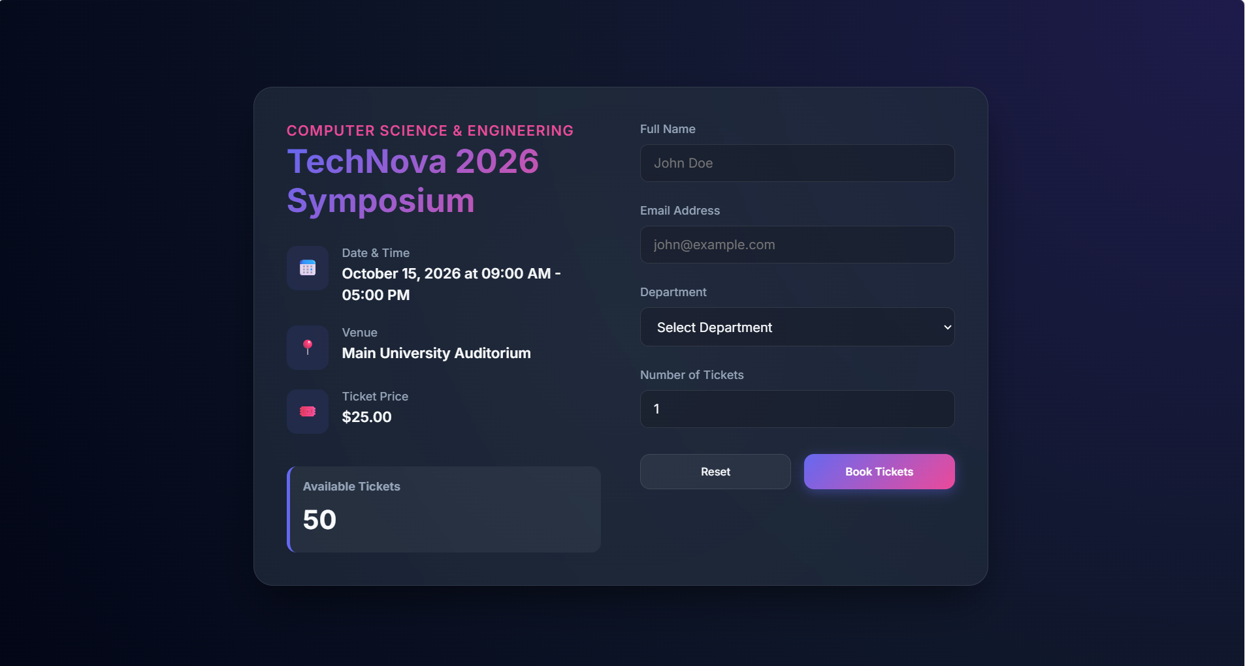
IMPLEMENTATION SCREENSHOTS
Home page
1
2
3
4
5
6
7
8
9

Slide 11
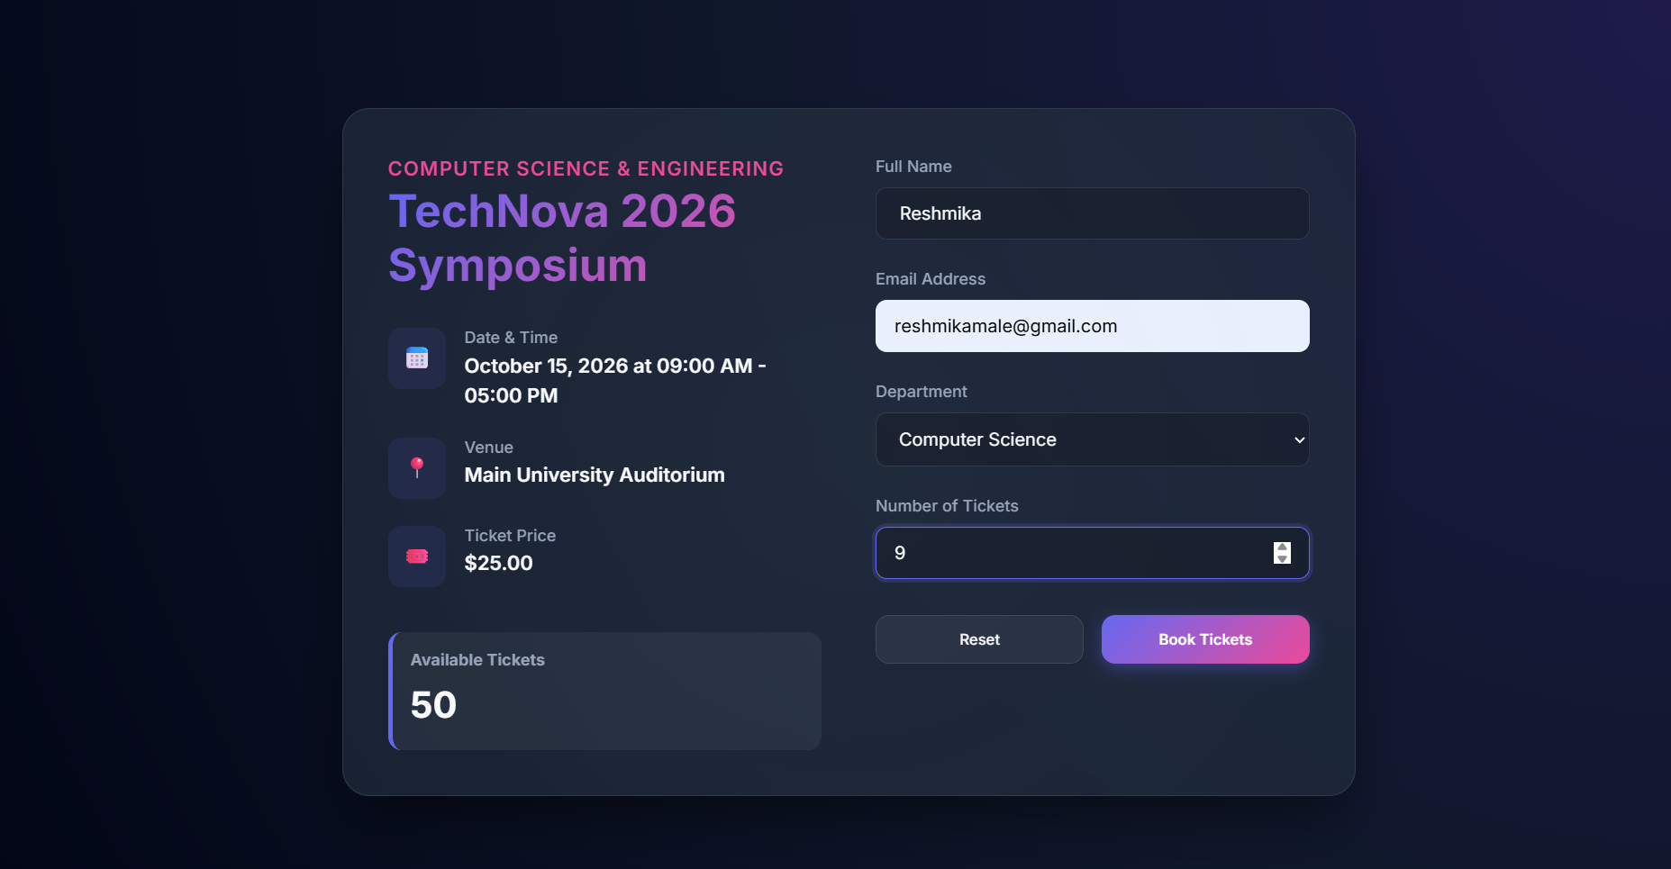
IMPLEMENTATION SCREENSHOTS
Login page
1
2
3
4
5
6
7
8(A)
9

Slide 12
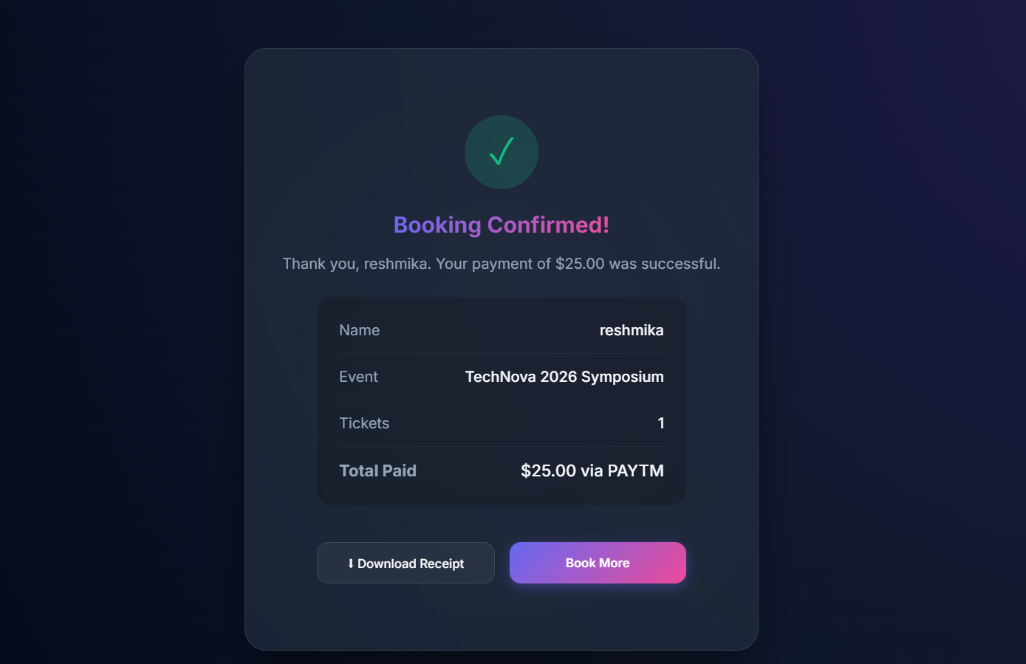
IMPLEMENTATION SCREENSHOTS
Main module
1
2
3
4
5
6
7
8(B)
9

Slide 13
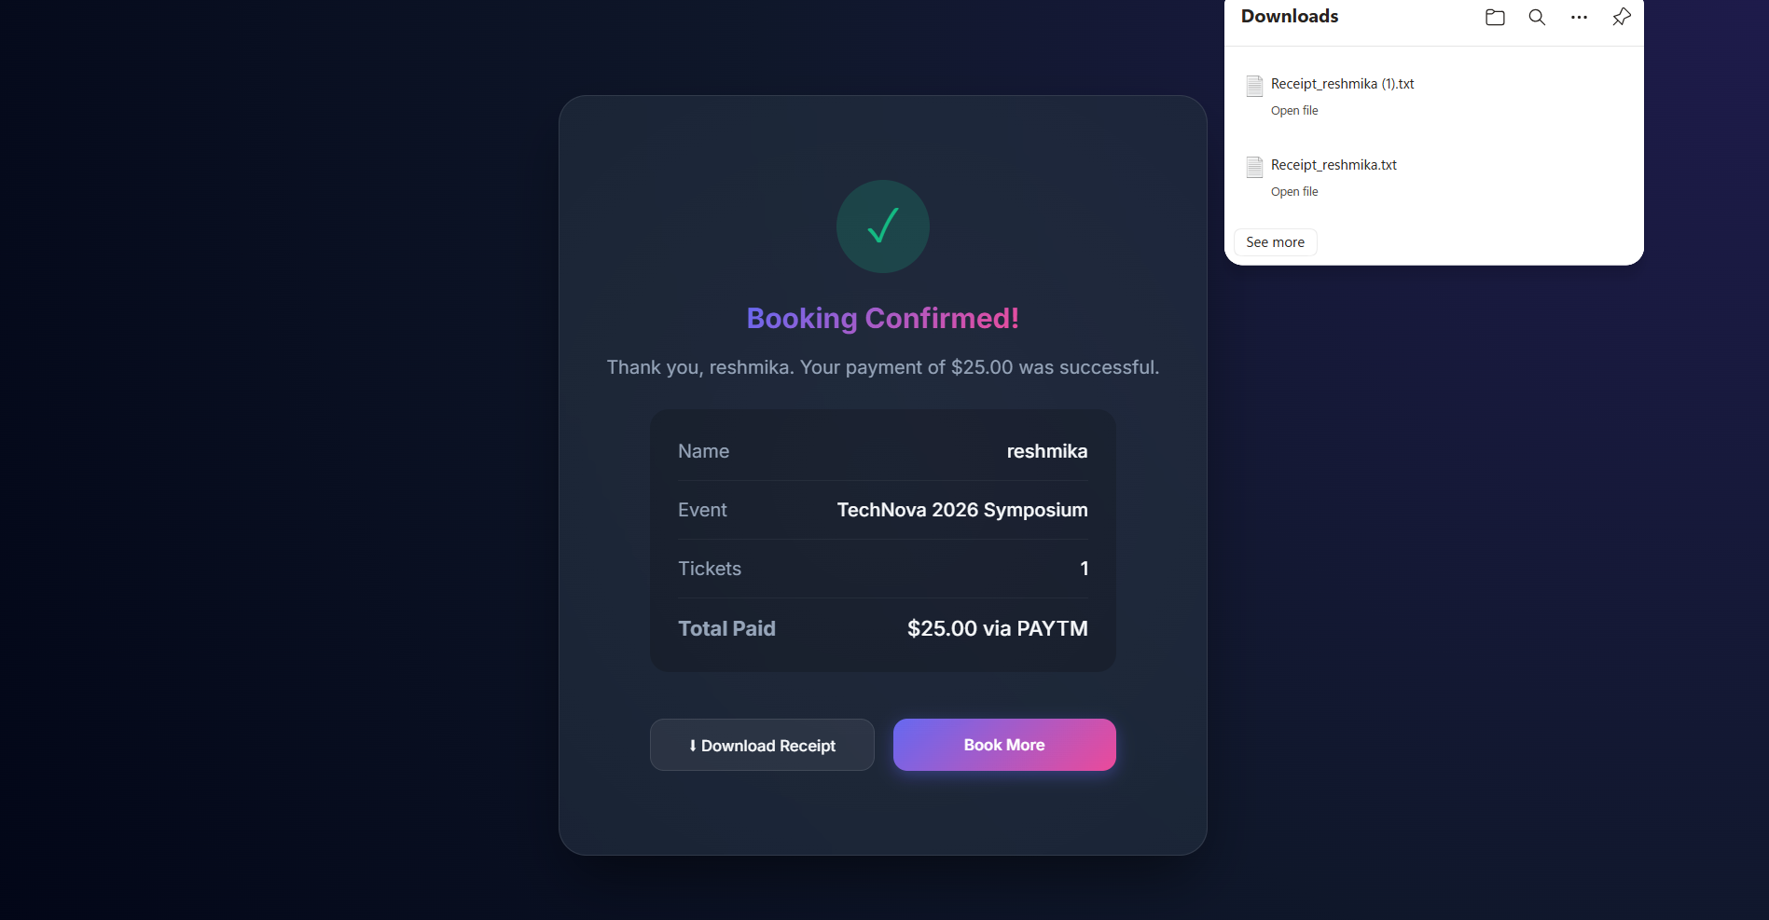
IMPLEMENTATION SCREENSHOTS
Output page
1
2
3
4
5
6
7
8(C)
9

Slide 14
ADVANTAGES & LIMITATIONS
1
ADVANTAGES
Provides 24/7 online ticket booking, eliminating the need for physical queues
Displays real-time event details and seat availability
Reduces manual errors and improves booking accuracy
Ensures secure transactions and data management
Offers fast and convenient booking experience for users
LIMITATIONS
Requires stable internet connection for access
Initial setup and development cost can be high
Dependency on server availability (downtime affects users)
Security risks like cyber attacks if not properly handled
Needs regular maintenance and updates
2
3
4
5
6
7
8
9

Slide 15
Thank you

